Slide 2
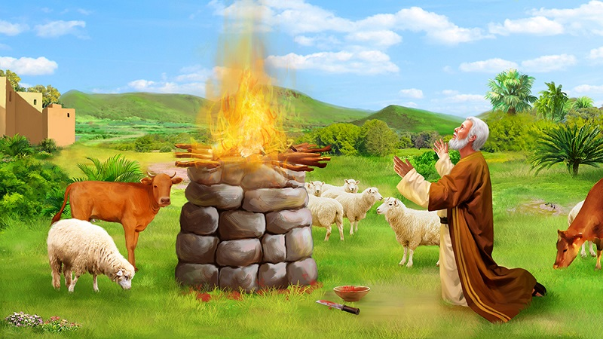

Slide 3
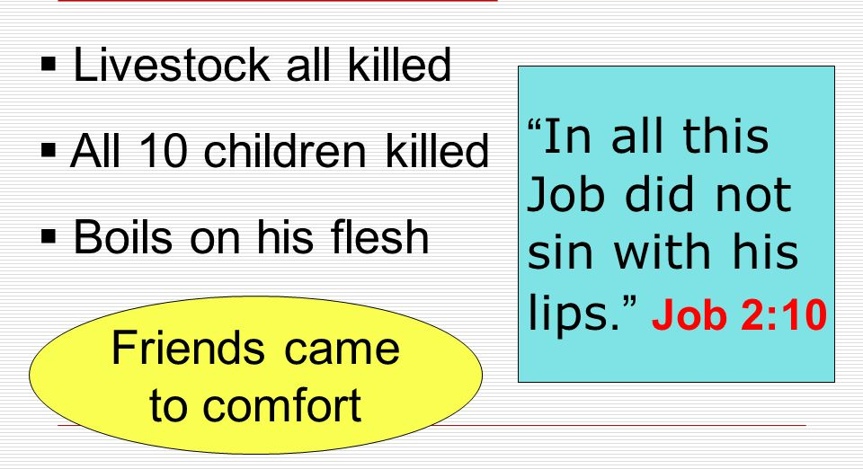
Job 1:22

Slide 4
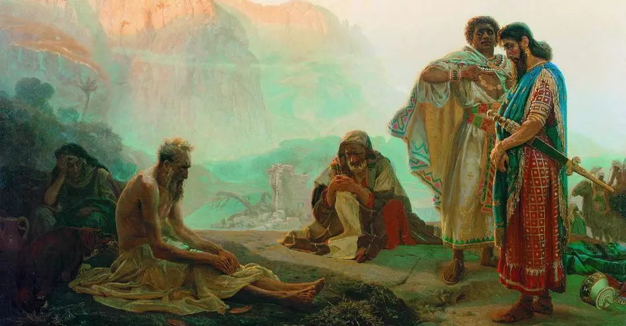
WHY HAS THIS HAPPENED TO ME?

Slide 5
Calvinistic Doctrine – Predestination
“Whatever happens is God’s Will!”
Not Everything That Happens IS God’s Will!
2 Peter 3:9 – “not willing that any should perish but that all should come to repentance.”
1 Timothy 2:4 “ who desires all men to be saved and to come to the knowledge of the truth."
It is NOT GOD’S WILL that MEN CONTINUE TO BE LOST – BUT THEY DO!
“WHY ME?” – “Why should such tragedy come to me?”

Slide 6
DEATH IS APPOINTED FOR ALL
Hebrews 9:27 “appointed for men to die once”
Ecclesiastes 3:2 “A time to be born, And a time to die”
Death is NOT the Ultimate Tragedy – Matthew 10:28
Precious Eternal Soul LOST is FAR WORSE that DEATH!
1 Thessalonians 4:13 “lest you sorrow as others who have no hope."

Slide 7
DEATH IS APPOINTED FOR ALL
1 Corinthians 15:55-57 (Hosea 13:14) “ thanks be to God, who gives us the victory through our Lord Jesus Christ."
2 Corinthians 4:16,17 “though our outward man is perishing, yet the inward man is being renewed day by day”
Romans 8:18 “the sufferings of this present time are not worthy to be compared with the glory which shall be revealed in us.”

Slide 8


Slide 9
WE REAP WHAT WE SOW!
Job 4:8 (Eliphaz) “Those who plow iniquity And sow trouble reap the same."
Galatians 6:7,8 “he who sows to his flesh will of the flesh reap corruption"
Just as sinful not to love your husband / wife as it is to divorce for some cause other than adultery!
Ephesians 5:25 “Husbands, love your wives”
Titus 2:4 “love their husbands"

Slide 10
SUFFER FINANCIALLY
Reckless Spending!
Only Blame OURSELVES!

Slide 11
ACCIDENTAL!
If our fault- Sow/Reap
Just victim of
something beyond
our control

Slide 12
THERE ARE OTHER WILLS AT WORK
James 4:1,2 Result of HATRED & BITTERNESS
NOT FROM GOD- the DEVIL is responsible!
1 Peter 5:8 “..., as a roaring lion, who walks about, seeking whom he may devour:"
James 4:7,8 “Resist the devil and he will flee from you.”
Certainly - this is NOT THE WILL OF GOD!

Slide 13
“Why doesn’t God just do away with the Devil?”
Numbers 21:4-9 “Numbers 21:8"Make a fiery serpent, and set it on a pole; and it shall be that everyone who is bitten, when he looks at it, shall live."
Today, instead of taking away SIN, He gave the CURE and left it up to man to TAKE IT! “Free Moral Agent”
James 1:12 “will receive the crown of life which the Lord has promised to those who love Him."
Joseph & Potiphar’s wife – Genesis 39:7-19

Slide 14
SOME THINGS JUST HAPPEN
Ecclesiastes 9:11
No Other Explanation!

Slide 15
THE THINGS WHICH GOD DOES
1 Peter 4:12 “Beloved, do not think it strange concerning the fiery trial which is to try you, as though some strange thing happened to you;” God “PERMITS” certain things
2 Corinthians 12:7-10 “a thorn in the flesh was given to me,… "My grace is sufficient for you…”For when I am weak, then I am strong."
2 Corinthians 1:3-7 “partakers of the sufferings, so also you will partake of the consolation."

Slide 16
THE THINGS WHICH GOD DOES
2 Corinthians 5:1-4 “we have a building from God, a house not made with hands, eternal in the heavens.”
2 Timothy 3:12 “all who desire to live godly in Christ Jesus will suffer persecution.”
1 Corinthians 10:13 “No temptation has overtaken you except such as is common to man; but God is faithful, who will not allow you to be tempted beyond what you are able, but with the temptation will also make the way of escape, that you may be able to bear it.”

Slide 17

“I just can’t deal with the death of a loved one.”
“I just can’t deal with terminal illness!”
YOU CAN!
GOD PROMISED THAT YOU COULD!

Slide 18
“Why would God send His Son
Into this Sinful World to Die
For ME?”
Why extend Forgiveness to ME?
Why extend Grace to ME?
John 3:16

